Slide 1
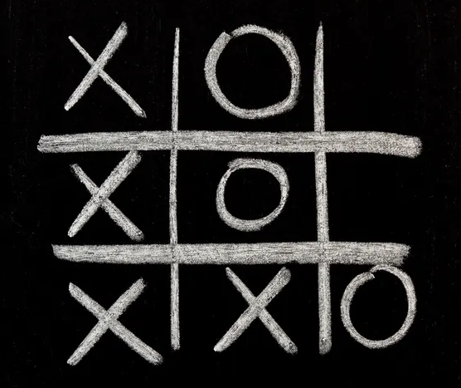
“The Game of Noughts and Crosses”
group 21216
Tatarintsev Vladislav
Makhov Nikolay
Pogibelnaya Olga

Slide 2
Gamepad

Slide 3
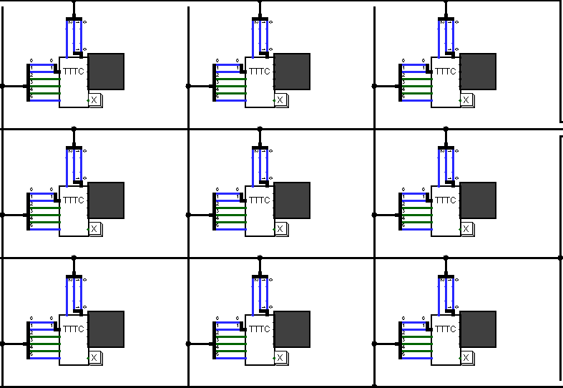
Playing field

Slide 4
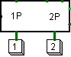
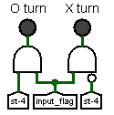
Game mode selection panel
Player move indicators

Slide 5
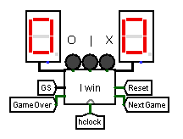
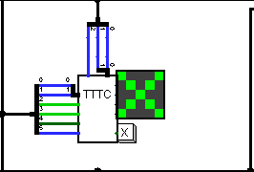
Cell with a cross
Game state display driver

Slide 6
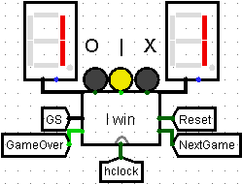
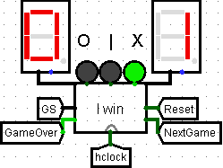
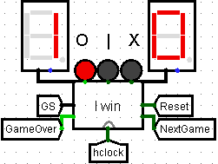
Draw
Crosses win
Noughts win

Slide 7
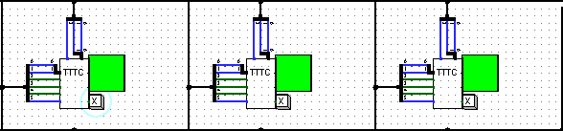


Illuminated row
Button “Reset”
Button “Continue”

Slide 8
Hardware improvements

Slide 9
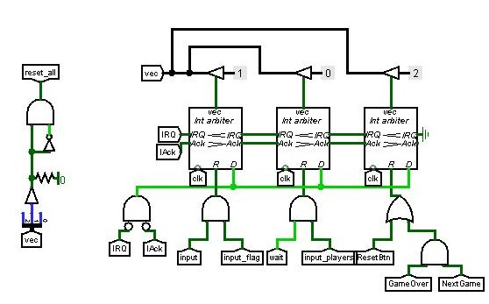
Interrupt arbiters

Slide 10
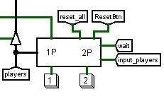
Count of players chip

Slide 11
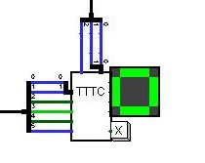
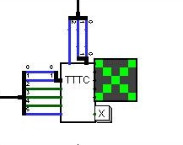
Symbol switching bit when playing between two players

Slide 12
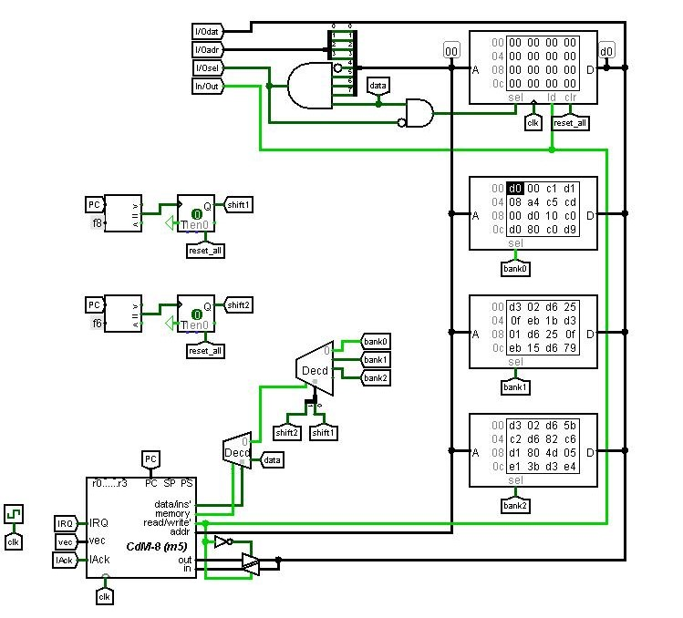
Banks of data

Slide 13
Software

Slide 14
Game mode
for two
checks for the victory of noughts
checks for the victory of crosses
AI
puts the third nought in a row
blocks 2 crosses in a row with a nought
puts a nought in the middle and corners
MAIN
distributes depending on the number of players (1 or 2)
checks for a player's win or draw (if single mode)

Slide 15
We have added the following improvements:
Score
"Continue" button
"Reset" button
A game for two people
Highlighting the winning row
LEDs indicating a whose move

Slide 16
